Slide 1
STABILITY STUDIES
Dr. Ganga Srinivasan
Professor
VESCOP,
Mumbai
Dr. Ganga Srinivasan

Slide 2
STABILITY STUDIES
ESSENTIAL ICH DEFINITIONS

Slide 3
Factors affecting Drug Stability Factors affecting Drug Stability
• Stability of the Active Pharmaceutical Ingredient
(API) from storage
• Interaction between the API and excipient –
Formulation Development
• Selection of dosage form
• Manufacturing process of drug product
• Selection of container closure packaging system
• Effect of storage (temperature, humidity and light)
• Selection of marketing image
• Handling of the finished products
Dr. Ganga Srinivasan

Slide 4
Purpose of Stability Testing
• The purpose of stability testing is to provide evidence
on how the quality of a drug substance or drug
product varies with time under the influence of a
variety of environmental factors such as temperature,
humidity and light.
• Stability testing permits the establishment of
recommended storage conditions, retest periods, and
shelf-lives.
– ICH harmonized Tripartite Guideline for Stability Testing of New Drug Substances and
Products [ICH Q1A]
Dr. Ganga Srinivasan

Slide 5
Drug Product Stability
• Stability characteristics of API or Drug Product is a critical
quality attribute of pharmaceutical product
• Stability Studies are used to:
– Establish how product changes over time under critical
environmental factors (temperature, heat and light)
– Determine appropriate product specifications
– Select marketing container closure system
– Determine appropriate storage conditions
– Justification of expiry of commercial product
– Provide necessary medical supplies
Dr. Ganga Srinivasan

Slide 6
Stability Testing
• Stability program must be written and followed:
– (a) used in determining appropriate storage
conditions and expiration date.
– Written program must include: Sample size and test
intervals, Storage conditions for samples,
– Reliable, meaningful, and specific test methods,
– Testing of drug product in marketed container,
– Testing of drug product for reconstitution at
dispensing time and reconstituted time.
Dr. Ganga Srinivasan

Slide 7
Stability Testing
– (b) An adequate number of batches must be tested to
determine an appropriate expiration date. A record of
such data must be maintained.
– Accelerated studies, combined with basic stability
information on the components, drug products, and
container-closure system, may be used to support
tentative expiration dates.
– Full shelf-life studies, if not available, are being
conducted.
Dr. Ganga Srinivasan

Slide 8
What is ICH?
ICH is a joint initiative involving both
regulators and research-based industry
representatives of the EU, Japan and the US
in scientific and technical discussions of the
testing procedures required to assess and
ensure the safety, quality and efficacy of
medicines.
Dr. Ganga Srinivasan

Slide 9
Who are the members?
ICH is comprised of representatives from the six cosponsoring
parties as well as three Observers and
the International Federation of Pharmaceutical
Manufacturers Associations (IFPMA):
Japan: the Ministry of Health & Welfare (MHW) and the
Japan Pharmaceutical Manufacturers Association (JPMA)
EU: the European Commission (EC) and the European
Federation of Pharmaceutical Industries’ Associations
(EFPIA)
USA: the Food & Drug Administration (FDA) and the
Pharmaceutical Research and Manufacturers of America
(PhRMA)
Observers: WHO, EFTA, and Canada
Dr. Ganga Srinivasan

Slide 10
What does ICH stand for?
The complete name of ICH is the
“International Conference on Harmonization
of Technical Requirements for Registration of
Pharmaceuticals for Human Use”.
Dr. Ganga Srinivasan

Slide 11
What is the purpose of ICH?
The objective of ICH is to increase
international harmonization of technical
requirements to ensure that safe, effective,
and high quality medicines are developed
and registered in the most efficient and cost effective manner.
Dr. Ganga Srinivasan

Slide 12
ICH Guidelines
ICH has developed over 45 harmonized guidelines
The ICH Topics are divided into four major
categories:
Quality (Q), i.e., those relating to chemical and
pharmaceutical Quality Assurance
Safety (S), i.e., those relating to in vitro and in vivo preclinical
studies
Efficacy (E), i.e., those relating to clinical studies in
human subject
Multidisciplinary topics (M), i.e., cross-cutting Topics which
do not fit uniquely into one of the above categories
Dr. Ganga Srinivasan

Slide 13
ICH Guidances
•Q1A(R2): Stability Testing of New Drug Substances and Products (November 2003);
•Q1B Photostability Testing of New Drug Substances and Product (November 1996);
•Q1C Stability Testing of New Dosage Forms (May 1997);
•Q1D Bracketing and Matrixing Designs for Stability Testing of New Drug Substances and
Products (January 2003);
•Q1E Evaluation of Stability Data (June 2004);
•Q1F Stability Data Package for Registration Applications in Climatic Zones III and IV,
Revision 1 (July 2004) – withdrawn
Q2 Analytical Validation
Q3A-Q3D Impurities
Q4- Q4B Pharmacoepias
Q5A-Q5E Quality of Biotechnology Products
•Q6A Specifications: Test Procedures and Acceptance Criteria for New Drug Substances and
New Drug Products: Chemical Substances (December 2000);
•Q6B Specifications: Test Procedures and Acceptance Criteria for Biotechnological/Biological
(August 1999);
Dr. Ganga Srinivasan

Slide 14
contd
•Q7A Good Manufacturing Practice Guidance for Active Pharmaceutical Ingredients (August
2001);
•Q8 Pharmaceutical Development (Draft) (February 2005);
Q9 Quality Risk Management
Q10 Pharmaceutical Quality Systems
Q11 Development and Manufacture of Drug Substances
Q12 Lifecycle Management
Dr. Ganga Srinivasan

Slide 15
Key Factors of Q1A(R2)
ICH condition contributing 80% of pharmaceutical market
Outlines minimum stability data package for new drug application.
It is not intended for INDs, ANDAs or sNDAs.
Harmonizes stability requirement for marketing application in EU,
Japan and US. Other countries adopt with some modifications.
Must use Validated Stability-Indicating analytical methods
Methods must cover physical, chemical, biological and microbiological attributes
Studies evaluated under thermal and elevated humidity to cover storage, shipment and subsequent use
Accelerated and intermediate used to evaluate impact of short term excursions.
Acceptance criteria should include individual and total upper limits for impurities and degradation products
No formal statistical analysis is needed if data show little degradation or variability.
Dr. Ganga Srinivasan

Slide 16
Multidisciplinary Guidelines
M1: MDRA Terminologies (Medical Dictionary for regulatory activities.
M2 : Electronic Standards
M3 : Non Clinical Safety Studies
M4 Common Technical Document
M5 Data Elements and Standards for Drug Dictionaries
M6 Gene Therapy
M7 Genotoxic Impurities
M8 Electronic Common Technical Document
Dr. Ganga Srinivasan

Slide 17
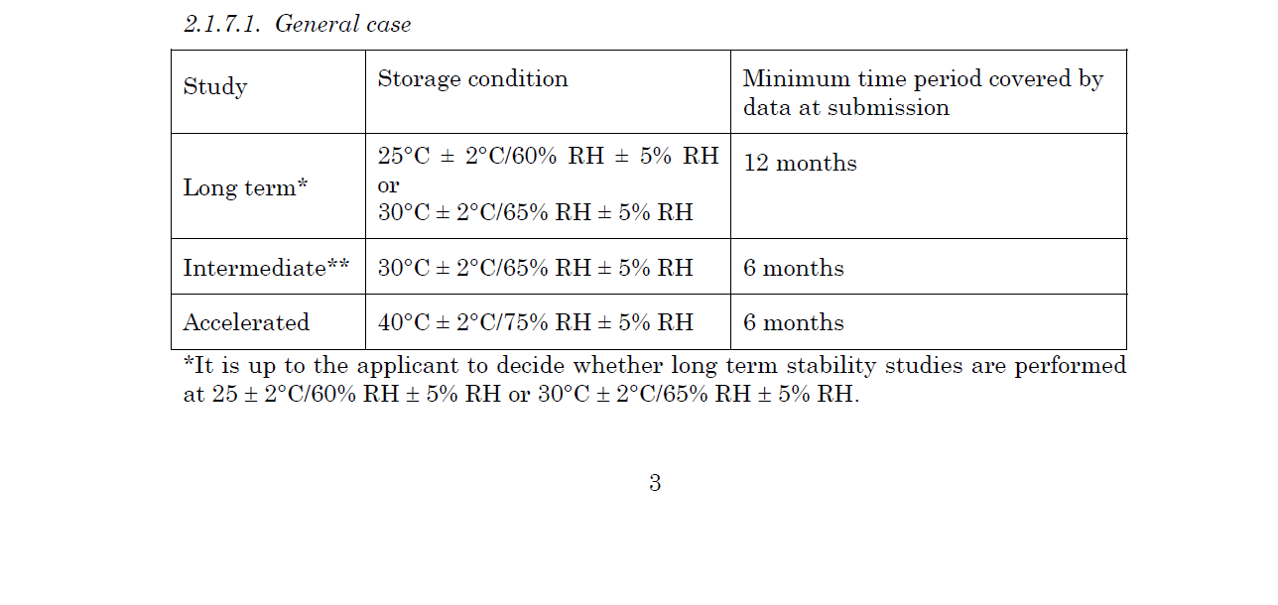

Dr. Ganga Srinivasan

Slide 18
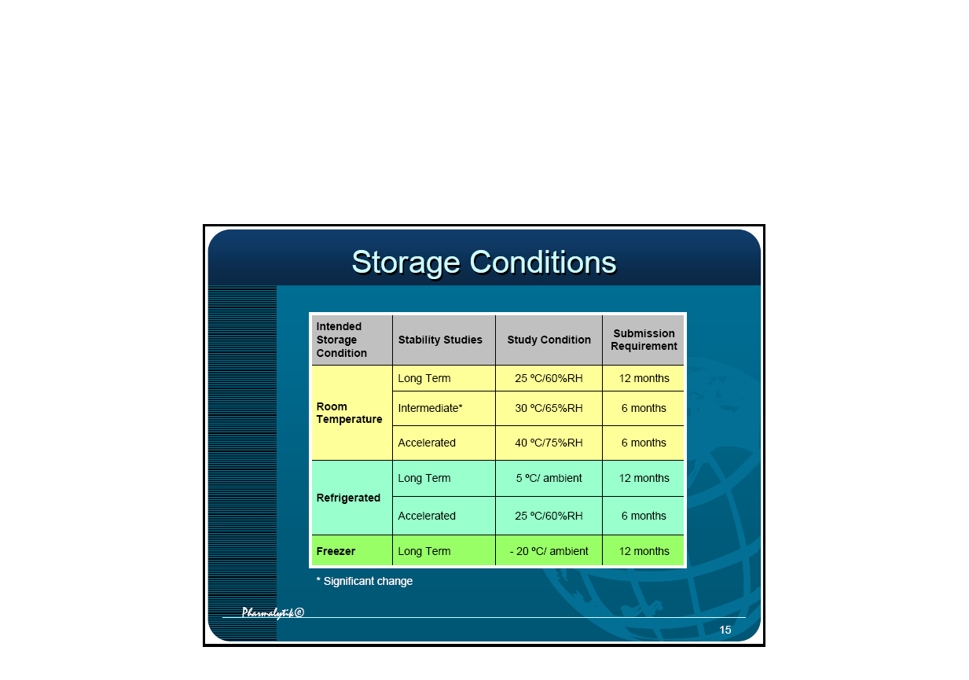
15
Storage Conditions
Dr. Ganga Srinivasan

Slide 19
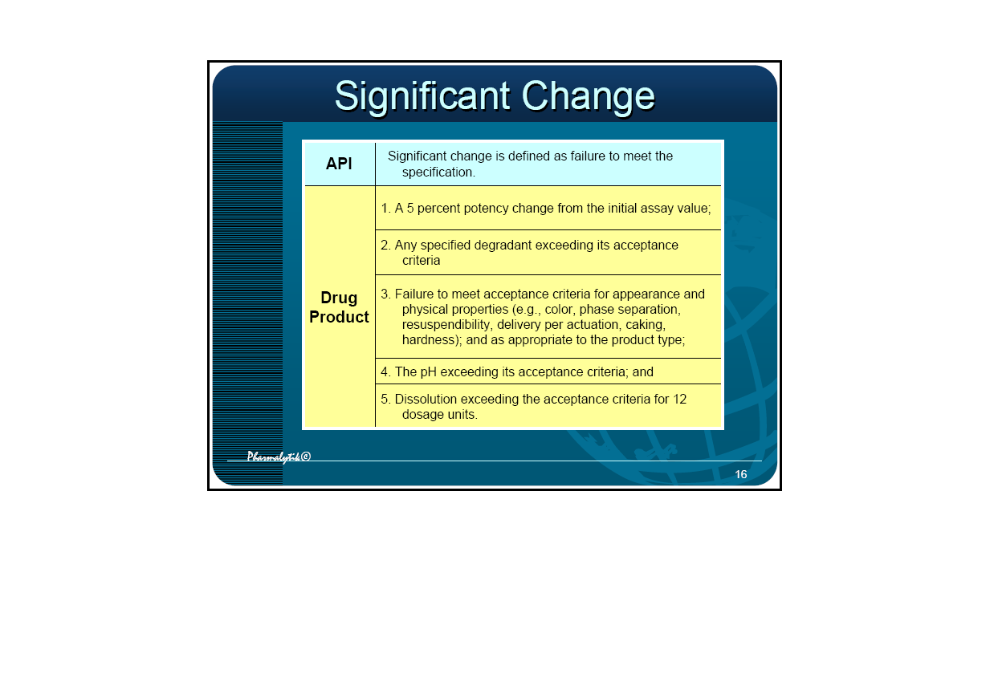
Significant Change
Dr. Ganga Srinivasan

Slide 20
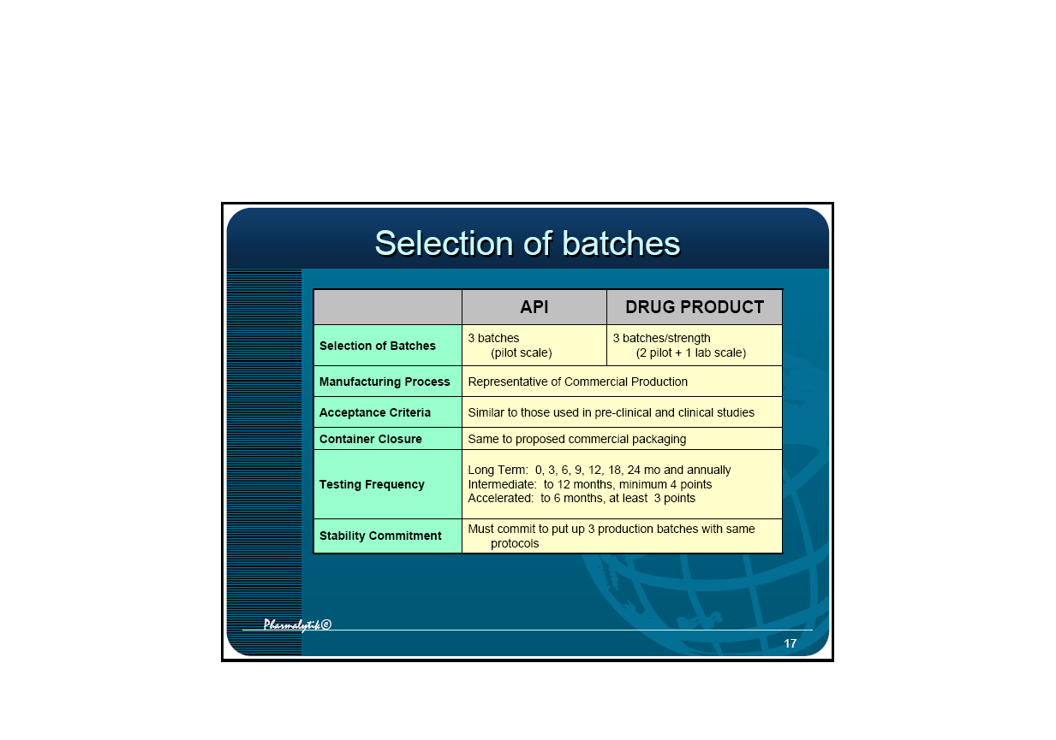
Selection of batches Selection of batches
Dr. Ganga Srinivasan

Slide 21
Q1B: Photostability Requirements Q1B: Photostability Requirements
Photostability:
two types of studies, exposure is cumulative from the light sources
• Forced degradation study to generate potential degradation products
– 2 X exposure to UV and fluorescent sources
• Confirmatory study to confirm product and package performance
– NLT 1.2 million lux hours + 200 watts/hrs per sq. meter
Light Sources:
– Option 1
• Dual output light sources, such as D65/ID65
• Simulates artificial day light fluorescent lamp
• Use Xenon or Metal Halide
– Option 2
• Tandem exposure to single light source types
• Cool white fluorescent lamp + near UV fluorescent lamp (320-400 nm)
• Accumulate exposure under one, then the other
Dr. Ganga Srinivasan

Slide 22
Q1D: Bracketing and Matrixing
Bracketing:
• Used for packaging extremes
• Assume that the intermediates are represented by the extremes
• For a range of strengths, strengths must be identical or very closely
related in composition
• Can be applied to different container sizes or fills of same
packaging system
• Bracketing design is NOT appropriate if extremes are not
demonstrated.
Matrixing:
• Define full design and reduced design (with examples)
• Assume that the stability of each subset of samples tested represent
the stability of all samples at a given time point
• Define what is needed for justification
• Covering different batches, different strengths, different sizes of the
same container and closure, and, possibly, in some cases, different
Container/closure system
Dr. Ganga Srinivasan

Slide 23
Q1E
•Evaluation of stability data
Dr. Ganga Srinivasan

Slide 24
Q1F: Zone III and IV Stability – withdrawn
• Applicable to Zone III (Hot & Dry) and Zone IV (Hot &
Humid)
• Issued in November 2003, withdrawn July 2006
• Contributing 20% of pharmaceutical markets
• Many smaller countries follow the WHO guidances
• Including the ASEAN community
• Long Term: 30 ºC/65%RH
Accelerated: 40 ºC/75%RH
Stress conditions: 50 ºC/Ambient to cover extreme hot
and dry conditions; 25 ºC/80%RH to cover extreme high
humidity
Dr. Ganga Srinivasan

Slide 25
ASEAN Counties
A.S.E.A.N.: Association of Southeast Asian Nations
(Cambodia, Brunei, Indonesia, Laos, Malaysia,
Philippines, Singapore, Thailand, Vietnam)
• Current ICH does not represent realistically the storage
conditions in these countries
• Average temperature and humidity is 27 ºC and 79%RH
• Recommend long term storage to be 30 ºC/75% RH, and
40 ºC/75% RH for accelerated condition – June 2004
• This condition is also preferred by some South American
countries such as Brazil
Dr. Ganga Srinivasan

Slide 26
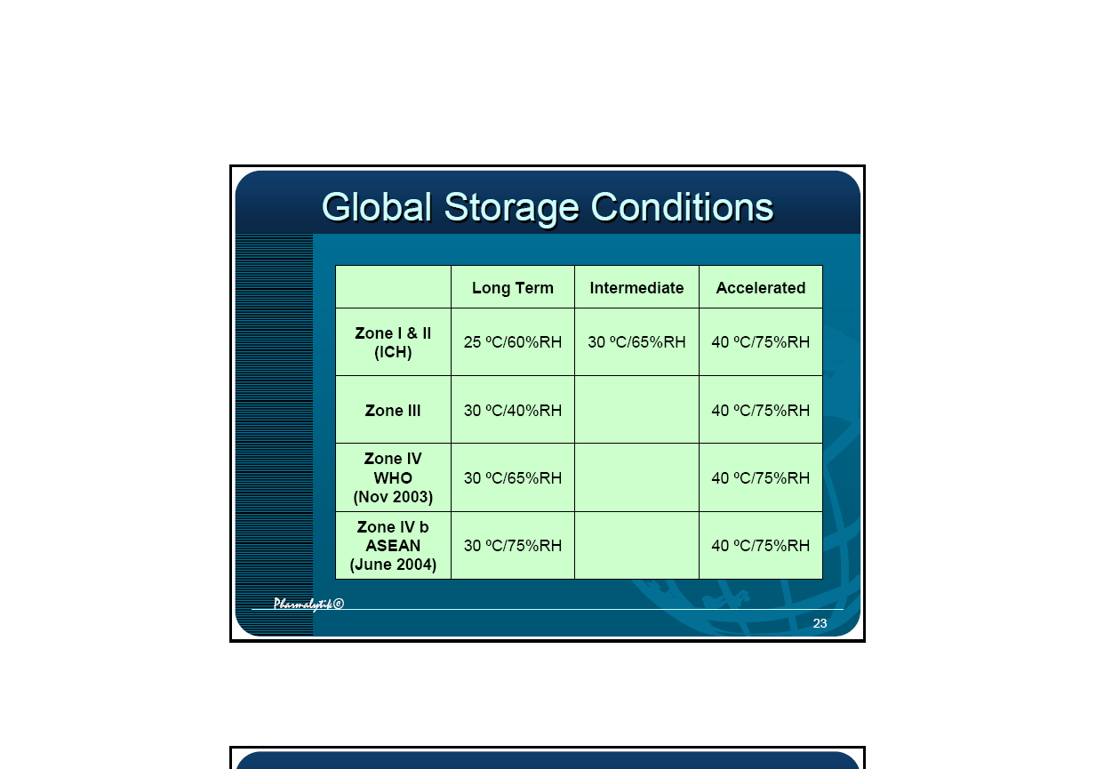
Global Storage Conditions
Dr. Ganga Srinivasan

Slide 27
Selected definitions
Re-test date
The date after which samples of an API should be examined to ensure that the material is still in compliance with the specification and thus suitable for use in the manufacture of a given FPP.
Shelf life (expiration dating period, conformance period)
The time period during which an API or a FPP is expected to remain within the approved shelf-life specification, provided that it is stored under the conditions defined on the container label.
Dr. Ganga Srinivasan
Notes:
Expiration date
The date placed on the container label of an API or FPP designating the time prior to which a batch of the product is expected to remain within the approved shelf life specification if stored under defined conditions, and after which it must not be used.
Re-test period
The period of time during which the API is expected to remain within its specification and, therefore, can be used in the manufacture of a given FPP, provided that the API has been stored under the defined conditions. After this period, a batch of an API destined for use in the manufacture of a FPP should be re-tested for compliance with the specification and then used immediately. A batch of an API can be re-tested multiple times and a different portion of the batch used after each re-test, as long as it continues to comply with the specification. For most biotechnological/biological substances known to be labile, it is more appropriate to establish a shelf life than a re-test period. The same may be true for certain antibiotics.
A re-test period of the API should be derived from the stability information, and a retest date should be displayed on the container label.
The long term testing should cover a minimum of 12 months' duration on at least three primary batches at the time of submission and should be continued for a period of time sufficient to cover the proposed shelf life.

Slide 28
Selected definitions
Formal stability studies
Long term and accelerated (and intermediate) studies undertaken on primary and/or commitment batches according to a prescribed stability protocol to establish or confirm the re-test period of an API or the shelf life of a FPP.
Stress testing – forced degradation (API)
Studies undertaken to elucidate the intrinsic stability of the API. Such testing is part of the development strategy and is normally carried out under more severe conditions than those used for accelerated testing.
Stress testing – forced degradation (FPP)
Studies undertaken to assess the effect of severe conditions on the FPP. Such studies include photostability testing (see ICH Q1B) and compatibility testing on APIs with each other in FDCs and API(s) with excipients during formulation development.
Dr. Ganga Srinivasan
Notes:
Data from formal stability studies should be provided on at least three primary batches of the API. The batches should be manufactured to a minimum of pilot scale by the same synthetic route as, and using a method of manufacture and procedure that simulates the final process to be used for production batches. The overall quality of the batches of API placed on formal stability studies should be representative of the quality of the material to be made on a production scale.
The stability studies should be conducted on the API packaged in a container closure system that is the same as or simulates the packaging proposed for storage and distribution.
Stability studies should include testing of those attributes of the API that are susceptible to change during storage and are likely to influence quality, safety, and/or efficacy.
The long term testing should cover a minimum of 12 months' duration on at least three primary batches at the time of submission and should be continued for a period of time sufficient to cover the proposed re-test period.
When available long term stability data on primary batches do not cover the proposed re-test period granted at the time of approval, a commitment should be made to continue the stability studies post approval in order to firmly establish the re-test period.
Where the submission includes long term stability data on three production batches covering the proposed re-test period, a post approval commitment is considered unnecessary. Otherwise, one of the following commitments should be made:
1. If the submission includes data from stability studies on at least three production batches, a commitment should be made to continue these studies through the proposed re-test period.
2. If the submission includes data from stability studies on fewer than three production batches, a commitment should be made to continue these studies through the proposed re-test period and to place additional production batches, to a total of at least three, on long term stability studies through the proposed re-test period.
3. If the submission does not include stability data on production batches, a commitment should be made to place the first three production batches on long term stability studies through the proposed retest date and on accelerated studies for 6 months.
3. The stability protocol used for long term studies for the stability commitment should be the same as that for the primary batches, unless otherwise scientifically justified.

Slide 29
Selected definitions
Primary batch
A batch of an API or FPP used in a formal stability study, from which stability data are submitted in a registration application for the purpose of establishing a re-test period or shelf life, respectively. A primary batch of an API should be at least a pilot scale batch. For a FPP, two of the three batches should be at least pilot scale batch, and the third batch a production batch.
Commitment batches
Production batches of a drug substance or drug product for which the stability studies are initiated or completed post approval through a commitment made in the registration application.
Dr. Ganga Srinivasan
Notes:
The long term testing of the FPP should cover a minimum of 12 months' duration on at least three primary batches at the time of submission and should be continued for a period of time sufficient to cover the proposed shelf life.
Stability testing should be conducted on the dosage form packaged in the container closure system proposed for marketing (including, as appropriate, any secondary packaging and container label).
When available long term stability data on primary batches of the FPP do not cover the proposed shelf life granted at the time of prequalification, a commitment should be made to continue the stability studies post approval in order to firmly establish the shelf life .
Where the submission includes long term stability data from three production batches covering the proposed shelf life, a post approval commitment is considered unnecessary. Otherwise, one of the following commitments should be made:
1. If the submission includes data from stability studies on at least three production batches, a commitment should be made to continue the long term studies through the proposed shelf life and the accelerated studies for 6 months.
2. If the submission includes data from stability studies on fewer than three production batches, a commitment should be made to continue the long term studies through the proposed retest period and the accelerated studies for 6 months, and to place additional production batches, to a total of at least three, on long term stability studies through the proposed shelf life and on accelerated studies for 6 months.
The stability protocol used for long term studies for the stability commitment should be the same as that for the primary batches, unless otherwise scientifically justified.

Slide 30
Selected definitions
Pilot (scale) batch
A batch of an API or FPP manufactured by a procedure fully representative of and simulating that to be applied to a full production scale batch. (For solid oral dosage forms, a pilot scale is generally, at a minimum, one-tenth that of a full production scale or 100,000 tablets or capsules, whichever is the larger.)
Production (scale) batch
A batch of an API or FPP manufactured at production scale by using production equipment in a production facility as specified in the application.
Dr. Ganga Srinivasan

Slide 31
Selected definitions
Supporting data
Data, other than those from formal stability studies, that support the analytical procedures, the proposed re-test period or shelf life, and the label storage statements. Such data include (1) stability data on early synthetic route batches of API, small-scale batches of materials, investigational formulations not proposed for marketing, related formulations, and product presented in containers and closures other than those proposed for marketing; (2) information regarding test results on containers; and (3) other scientific rationales.
Dr. Ganga Srinivasan

Slide 32
Selected definitions
Specification - Release
The combination of physical, chemical, biological, and microbiological tests and acceptance criteria that determine the suitability of a drug product at the time of its release.
Specification - Shelf life
The combination of physical, chemical, biological, and microbiological tests and acceptance criteria that determine the suitability of an API throughout its re-test period, or that anFPP should meet throughout its shelf life.
Mass balance
The process of adding together the assay value and levels of degradation products to see how closely these add up to 100% of the initial value, with due consideration of the margin of analytical error.
Dr. Ganga Srinivasan
Notes:
Shelf life acceptance criteria should be derived from consideration of all available stability information. It may be appropriate to have justifiable differences between the shelf life and release acceptance criteria based on the stability evaluation and the changes observed on storage.

Slide 33
Planning stability studies and reporting results
Model Stability Protocol and Report of API

Slide 34
Stability Protocol and Report
Batches tested
General information
Container/closure system
Literature and supporting data
Stability-indicating analytical methods
Testing plan
Test parameters
Test results
Other requirements (post-approval commitments)
Conclusions
Result sheets must bear date and responsible person signature / QA approval
Dr. Ganga Srinivasan

Slide 35
Illustrative data of API stability batches
Batch number
Date of manufacture
Site of manufacture
Batch size (kg)
Primary packing materials
Date of initial analysis
The batches should be representative of the manufacturing process and should be manufactured from different batches of key intermediates.
Dr. Ganga Srinivasan

Slide 36
Illustrative data of capsule/tablet stability batches
Batch number
Date of manufacture
Site of manufacture
Batch size (kg)
Batch size (number of units)
Primary packing materials
Date of initial analysis
Batch number of the API
The batches should be representative of the manufacturing process and should be manufactured from different batches of APIs.
Dr. Ganga Srinivasan

Slide 37
Stability Testing - API
Stress testing (forced degradation)
Regulatory stability testing

Slide 38
ICH guidelines on stress testing
Standard | Title and reference
ICH Q1A(R2) | Stability Testing of New Drug Substances and Products (the parent guideline)
ICH Q1B | Photostability Testing of New Drug Substances and Products
ICH Q2B | Validation of Analytical Procedures: Methodology
ICH Q3A(R) | Impurities in New Drug Substances
ICH Q3B(R) | Impurities in New Drug Products
Dr. Ganga Srinivasan

Slide 39
Forced degradation tests
To identify potential degradants (degradation pathways) of the API and assess if they can be formed during manufacture or storage of the FPP (intrinsic stability of the API).
To validate the stability indicating power of the analytical procedures.
To identify stability-affecting factors such as ambient temperature, humidity and light and to select packing materials, which protect the FPP against such effects.
No standard method for testing.
Dr. Ganga Srinivasan
Notes:
Q1A(R2) STABILITY TESTING OF NEW DRUG SUBSTANCES AND PRODUCTS
2.1.2 Stress Testing
Stress testing of the drug substance can help identify the likely degradation products, which can in turn help establish the degradation pathways and the intrinsic stability of the molecule and validate the stability indicating power of the analytical procedures used. The nature of the stress testing will depend on the individual drug substance and the type of drug product involved.
Stress testing is likely to be carried out on a single batch of the drug substance. It should include the effect of temperatures (in 10°C increments (e.g., 50°C, 60°C, etc.) above that for accelerated testing), humidity (e.g., 75% RH or greater) where appropriate, oxidation, and photolysis on the drug substance. The testing should also evaluate the susceptibility of the drug substance to hydrolysis across a wide range of pH values when in solution or suspension. Photostability testing should be an integral part of stress testing. The standard conditions for photostability testing are described in ICH Q1B.
Examining degradation products under stress conditions is useful in establishing degradation pathways and developing and validating suitable analytical procedures. However, it may not be necessary to examine specifically for certain degradation products if it has been demonstrated that they are not formed under accelerated or long term storage conditions.
Results from these studies will form an integral part of the information provided to regulatory authorities.
2.2.4. Container Closure System
Stability testing should be conducted on the dosage form packaged in the container closure system proposed for marketing (including, as appropriate, any secondary packaging and container label). Any available studies carried out on the drug product outside its immediate container or in other packaging materials can form a useful part of the stress testing of the dosage form or can be considered as supporting information, respectively.

Slide 40
Prequalification experience
Results | Comments
Deceptive | Degradation level is good (<15%) but no relevant degradants are observed
Predictive | Degradation level is good (<15%) and at least one or all relevant degradants are observed
Useless | Between 15 and 100% degradation but no relevant degradants observed
Dr. Ganga Srinivasan

Slide 41
Requirements for predictive stress conditions
Should lead to the degradation of the main compound, but not more than 5-15%.
Should lead to a good predictability of degradation pathways (i.e., a low probability of "drastic" or "false" degradation)
Should be conducted for no longer than three months.
Dr. Ganga Srinivasan
Notes:
Q2B VALIDATION OF ANALYTICAL PROCEDURES: METHODOLOGY
1.2 Assay and Impurity Test(s)
1.2.2 Impurities are not available
If impurity or degradation product standards are unavailable, specificity may be demonstrated by comparing the test results of samples containing impurities or degradation products to a second well-characterized procedure e.g.: pharmacopoeial method or other validated analytical procedure (independent procedure). As appropriate, this should include samples stored under relevant stress conditions: light, heat, humidity, acid/base hydrolysis and oxidation.
▪ For the assay, the two results should be compared.
▪ For the impurity tests, the impurity profiles should be compared.
Peak purity tests may be useful to show that the analyte chromatographic peak is not attributable to more than one component (e.g., diode array, mass spectrometry).
Q3B(R) IMPURITIES IN NEW DRUG PRODUCTS
3. ANALYTICAL PROCEDURES
The registration application should include documented evidence that the analytical procedures have been validated and are suitable for the detection and quantitation of degradation products (see ICH Q2A and Q2B guidelines on analytical validation). In particular, analytical procedures should be validated to demonstrate specificity for the specified and unspecified degradation products. As appropriate, this validation should include samples stored under relevant stress conditions: light, heat, humidity, acid/base hydrolysis, and oxidation. When an analytical procedure reveals the presence of other peaks in addition to those of the degradation products (e.g., the drug substance, impurities arising from the synthesis of the drug substance, excipients and impurities arising from the excipients), these peaks should be labeled in the chromatograms and their origin(s) discussed in the validation documentation.
The quantitation limit for the analytical procedure should be not more than (:~) the reporting threshold.
Degradation product levels can be measured by a variety of techniques, including those that compare an analytical response for a degradation product to that of an appropriate reference standard or to the response of the new drug substance itself. Reference standards used in the analytical procedures for control of degradation products should be evaluated and characterised according to their intended uses. The drug substance can be used to estimate the levels of degradation products. In cases where the response factors are not close, this practice can still be used if a correction factor is applied or the degradation products are, in fact, being overestimated. Acceptance criteria and analytical procedures, used to estimate identified or unidentified degradation products, are often based on analytical assumptions (e.g., equivalent detector response). These assumptions should be discussed in the registration application.
Differences between the analytical procedures used during development and those proposed for the commercial product should also be discussed.

Slide 42
Stress testing of API in solution
Storage conditions
Testing period*
pH ± 2, room temperature
2 weeks
pH ± 7, room temperature
2 weeks
pH ± 10-12, room temperature
2 weeks
H₂O₂, 0.1-2% at neutral pH, room temperature
24 hours
* Storage times given or 5-15% degradation, whatever comes first
Dr. Ganga Srinivasan
Notes:
For many FPPs, especially most solid oral dosage forms, testing the API in solution may be of limited relevance. However, stress testing in solution is generally seen as relevant both for elucidation of degradation pathways and for specificity testing of the analytical method.
In special cases, however, testing the API at ele­vated temperature in solution may be of interest (e.g., to predict stability during autoclaving of a solution). Therefore, testing an API in solution under elevated temperatures should be considered on a case-by-case basis.
Routine testing of radical initiators or transition metals such as Fe³⁺ and Cu²⁺ as initiators or catalysts for oxidative degradation are not generally regarded as relevant, and a case-by-case approach is recommended.

Slide 43
Regulatory or formal stability testing
Storage temperature (°C) | Relative humidity (%) | Minimum time period covered by data at submission (months)
Accelerated: 40±2 | 75±5 | 6
Intermediate: 30±2 | 65±5 | 12
Long term: 25±2 | 60±5 | 12 (6)
Dr. Ganga Srinivasan

Slide 44

Stability Room
A special cabinet for each condition
Design, construction, qualification, monitoring
Costs of operation including R + D failures
Time
Do we need new standard conditions?
Dr. Ganga Srinivasan

Slide 45
Stability results
A storage statement should be proposed for the labeling (if applicable), which should be based on the stability evaluation of the API.
A re-test period should be derived from the stability information, and the approved retest date should be displayed on the container label.
An API is considered as stable if it is within the defined/regulatory specifications when stored at 30±2ºC and 65±5% RH for 2 years and at 40±2ºC and 75±5%RH for 6 months.
Dr. Ganga Srinivasan

Slide 46
Stability testing - FPP
Regulatory stability testing
Stress testing (forced degradation)

Slide 47
Potential instability issues of FPPs
Loss/increase in concentration of API
Formation of (toxic) degradation products
Modification of any attribute of functional relevance
Alteration of dissolution time/profile or bioavailability
Decline of microbiological status
Loss of package integrity
Reduction of label quality
Loss of pharmaceutical elegance and patient acceptability
Dr. Ganga Srinivasan

Slide 48
3.11.1 Stability-indicating quality parameters
Stability studies should include testing of those attributes of the FPP that are susceptible to change during storage and are likely to influence quality, safety and/or efficacy. For instance, in case of tablets:
  ♦ appearance ♦ hardness
  ♦ friability ♦ moisture content
  ♦ dissolution time ♦ degradants
  ♦ assay ♦ microbial purity
Dr. Ganga Srinivasan

Slide 49
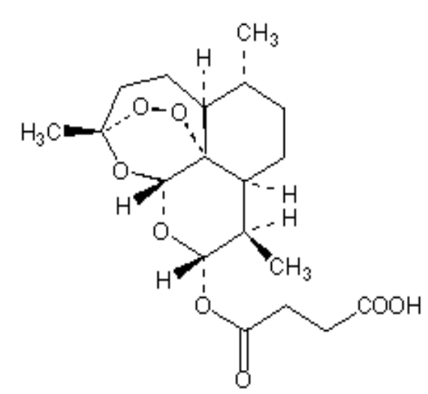
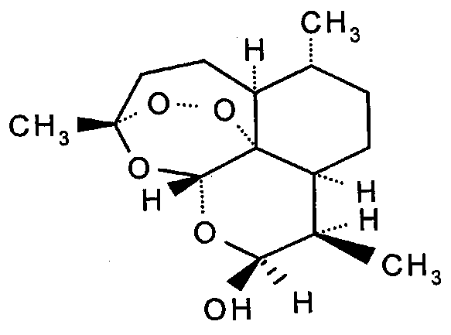
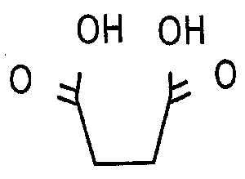
Increase in concentration of API
During stability studies of Artesunate, the assay results were increasing. The hydrolysis may yield artenimol and succinic acid. The latter can justify the increase in assay. The assay method is „stability indicating” but not specific.
+
Dr. Ganga Srinivasan

Slide 50
Selection of Batches
At the time of submission data from stability studies should be provided for batches of the same formulation and dosage form in the container closure system proposed for marketing.
Stability data on three primary batches are to be provided. The composition, batch size, batch number and manufacturing date of each of the stability batches should be documented and the certificate of analysis at batch release should be attached.
Where possible, batches of the FPP should be manufactured by using different batches of the API.
Dr. Ganga Srinivasan

Slide 51
Significant Change of FPPs
A 5% change in assay from its initial value.
Any degradation product exceeding its acceptance criterion.
Failure to meet the acceptance criteria for appearance, physical attributes, and functionality test (e.g., color, phase separation, hardness).
As appropriate for the dosage form, e.g., failure to meet the acceptance criteria for dissolution for 12 dosage units.
Dr. Ganga Srinivasan

Slide 52
Pitfall
The assay value is still within the limits but the change during stability is more than 5.0%
Example
  Release assay limit: 95.0 – 105.0%
  Stability assay limit: 92.5 – 105.0%
  Release assay: 101.0% (within spec)
  24-Month assay: 93.0% (within spec)
  Loss in potency: 8.0%.
  This is a significant change.
Dr. Ganga Srinivasan

Slide 53
2.2.3 Tests at elevated temperature and/or extremes of humidity (ICH-Q1F)
Special transportation and climatic conditions outside the storage conditions recommended in this guideline should be supported by additional data. For example, these data can be obtained from studies on one batch of drug product conducted for up to 3 months at 50°C/ambient humidity to cover extremely hot and dry conditions and at 25°C/80% RH to cover extremely high humidity conditions.
Stability testing at a high humidity condition, e.g., 25°C/80% RH, is recommended for solid dosage forms in water-vapour permeable packaging, e.g., tablets in PVC/aluminum blisters, intended to be marketed in territories with extremely high humidity conditions in Zone IV. However, for solid dosage forms in primary containers designed to provide a barrier to water vapour, e.g. aluminum/aluminum blisters, stability testing at a storage condition of extremely high humidity is not considered necessary.
Dr. Ganga Srinivasan

Slide 54
Stress testing of FPPs in solid state
Storage conditions
Testing period*
40°C, 75 % RH; open storage**
3 months
50-60 °C, ambient RH; open storage
3 months
Photostability; according to ICH
according to ICH
* 3 months or 5-15% degradation, whatever comes first
** For API1-API2, or API-excipient, or FPP without packing material, typically a thin layer of material is spread in a Petri dish. Open storage is recommended, if possible.
Dr. Ganga Srinivasan
Notes:
During stress testing, degradation products can be observed that are not formed during accelerated or long-term stability studies. Hence, these degradation products need not always to be examined.
Results from submissions in the prequalification project show that the typically applied conditions usually generate a lot of irrelevant degradation products. Chromatograms cannot be evaluated if drastic conditions are applied and many second- and third-generation degradation products are formed
An optimal degradation pattern generated during stress testing would show only those degradation products observed at the end of shelf life in formal stability studies and those that might appear if the API or FPP is not handled or packed properly. Chromatograms thus obtained will be representative and not too complicated to evaluate.
Routine testing of radical initiators or transition metals such as Fe³⁺ and Cu²⁺ as initiators or catalysts for oxidative degradation are not generally regarded as relevant, and a case-by-case approach is recommended.

Slide 55
Stability studies
API and FPP
Evaluation of results

Slide 56
Evaluation
A systematic approach should be adopted in the presentation and evaluation of the stability information.
Where the data show so little degradation and so little variability that it is apparent from looking at the data that the requested shelf life will be granted, it is normally unnecessary to go through the formal statistical analysis; providing a justification for the omission should be sufficient.
An approach for analysing data on a quantitative attribute that is expected to change with time is to determine the time at which the 95% one-sided confidence limit for the mean curve intersects the (lower) acceptance criterion (95% assay).
Dr. Ganga Srinivasan

Slide 57
Evaluation – Best Case
Tabulate and plot stability data on all attributes at all storage conditions and evaluate each attribute separately.
No significant change at accelerated conditions within six (6) months.
Long-term data show little or no variability and little or no change over time.
Dr. Ganga Srinivasan

Slide 58
Evaluation – Best Case
Accelerated data show little or no variability and little or no change over time.
Statistical analysis is normally unnecessary.
Proposed retest period or shelf life = double of period covered by long-tem data (X) but NMT X + 12 months
A retest period or shelf life granted on the basis of extrapolation should always be verified by additional long-term stability data
Dr. Ganga Srinivasan

Slide 59
Visible variability and trend
Is there "little or no data variability"? (High variability without change over time suggests potential problem with accuracy/precision of analytical method.)
Is there "little or no change-over-time" in stability data?
Dr. Ganga Srinivasan

Slide 60
Visible variability and trend
The simple linear regression analysis yields the equation:
Y = slope X + intercept
where Y is the assay, X is the time factor expressed in months, the slope is the degradation rate and the intercept is the assay at time = 0. Regression analysis provides two additional factors: the p-value of the slope and the standard deviation about the regression line S_{X/Y}
Dr. Ganga Srinivasan

Slide 61
Visible variability and trend
The p-value is the smallest level of significance that would lead to rejection of the null hypothesis. (The ICH Q1A states p = 0.25 for accepting the equality of slopes and zero intercepts of regression lines of different batches.)
Variability is taken to be reflected by the spread of data around the previously derived regression line. The standard deviation about the regression line S_{Y/X} is a measure of this spread.
Dr. Ganga Srinivasan
Notes:
2.1.9. Evaluation
An approach for analyzing the data on a quantitative attribute that is expected to change with time is to determine the time at which the 95% one-sided confidence limit for the mean curve intersects the acceptance criterion. If analysis shows that the batch-to-batch variability is small, it is advantageous to combine the data into one overall estimate. This can be done by first applying appropriate statistical tests (e.g., p values for level of significance of rejection of more than 0.25) to the slopes of the regression lines and zero time intercepts for the individual batches. If it is inappropriate to combine data from several batches, the overall re-test period should be based on the minimum time a batch can be expected to remain within acceptance criteria.
The nature of any degradation relationship will determine whether the data should be transformed for linear regression analysis. Usually the relationship can be represented by a linear, quadratic, or cubic function on an arithmetic or logarithmic scale. Statistical methods should be employed to test the goodness of fit of the data on all batches and combined batches (where appropriate) to the assumed degradation line or curve.
Limited extrapolation of the real time data from the long term storage condition beyond the observed range to extend the re-test period can be undertaken at approval time, if justified. This justification should be based on what is known about the mechanism of degradation, the results of testing under accelerated conditions, the goodness of fit of any mathematical model, batch size, existence of supporting stability data, etc. However, this extrapolation assumes that the same degradation relationship will continue to apply beyond the observed data.
Any evaluation should cover not only the assay, but also the levels of degradation products and other appropriate attributes.

Slide 62
Visible variability and trend
To account for the relative nature of the data variability, it is suggested here to employ the Capability Index, C_{pk}, a term borrowed from the field of statistical process control. The capability of a process is defined as 6σ, which is the range where 99.7% of the measurements lie (assuming a normal distribution).
Dr. Ganga Srinivasan

Slide 63
Process capability index, Cp
acceptance limits UCL - LCL
Cp = =
process capability 6σ*
σ* ... is the measured standard deviation of the process
acceptance limits UCL - LCL
C_{pk} = =
process capability 6 S_{Y/X}
Dr. Ganga Srinivasan

Slide 64
Visible variability and trend
Perform linear regression analysis on either accelerated or long-term stability data
p > 0.25. Yes. There is little or no a change-over-time
Cpk > 2.5. Yes. There is little or no data variability
Dr. Ganga Srinivasan

Slide 65
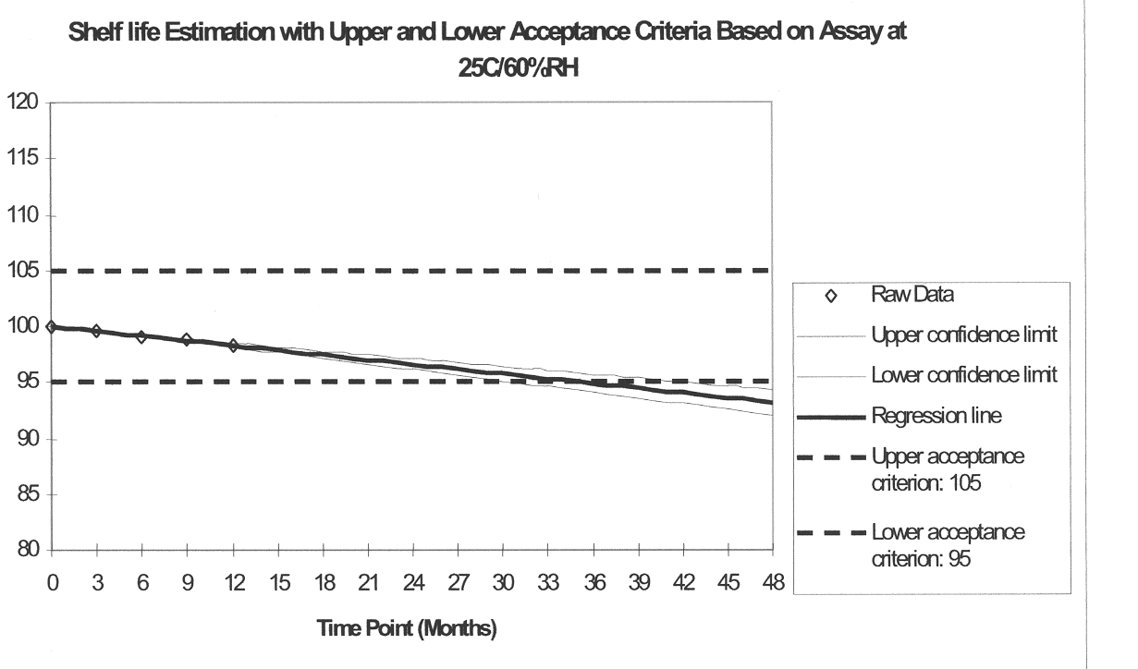
ICH-Q1E Evaluation for Stability Data
Dr. Ganga Srinivasan

Slide 66
Evaluation – Change with Time
The hypothetical figure in the former slide illustrates that the extrapolated shelf life is 29 months (25ºC/60%RH) and there is only a 5% chance that this estimate will be high. Such a plot covers assay values from 100% down to 95%.
The majority of degradation processes results in an essentially linear line in this range of the label claim thus the method is generally applicable for the estimation of the expiry date at the studied storage conditions.
Dr. Ganga Srinivasan

Slide 67
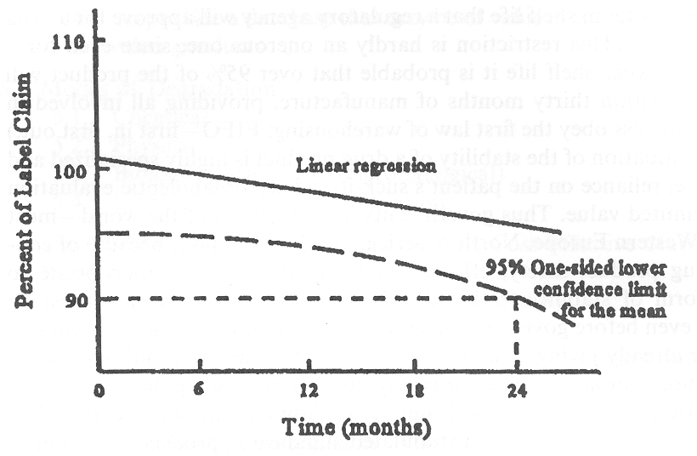
Carstensen, J.T. – Drug stability
Dr. Ganga Srinivasan

Slide 68
Evaluation – Change with Time*
The hypothetical figure in the former slide illustrates that the shelf life is 24 months (at a given temperature). There is a 5% chance that this estimate will be high. Such a plot covers potency values from 100% down to 90%.
* DRUG STABILITY — Principles and Practices
Edited by Jens T. Carstensen and C. T. Rhodes
Third edition, revised and expanded (2000)
Marcel Dekker, Inc., 270 Madison Avenue, New York,
Dr. Ganga Srinivasan

Slide 69
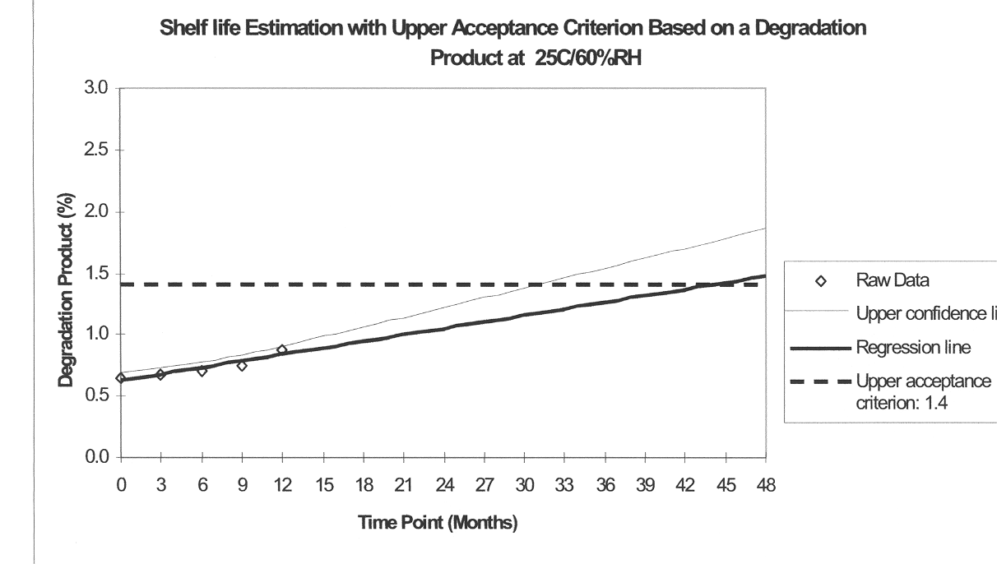
ICH-Q1E Evaluation for Stability Data
Dr. Ganga Srinivasan

Slide 70
Evaluation – Change with Time
The hypothetical figures in the former slides illustrate that the shelf life is 31-32 months (25ºC/60%RH) and there is only a 5% chance that this estimate will be high. Such a plot covers degradant values from 0.6% up to 1.4%.
For FPPs in semipermeable containers, loss of vehicle can result in an increase in the API concentration. In such cases, the point where the upper 95% confidence bound intersects the 105% assay value will define the conformance period.
Dr. Ganga Srinivasan

Slide 71
Release and shelf-life specifications
It may be appropriate to have justifiable differences between the shelf life and release acceptance criteria based on the stability evaluation and the changes observed on storage.
Shelf-life acceptance criteria should be derived from consideration of all available stability information.
Release and shelf-life dissolution acceptance criteria (Q and t) must be the same
List of approved suppliers.
Dr. Ganga Srinivasan

Slide 72
Commitment
For confirmation of provisional (tentative) shelf-life, real-time data are required
First 3 production batches on stability
Follow up stability testing (FUST) – one batch per year
Dr. Ganga Srinivasan

Slide 73
Additional or New Stability Data
Variations affecting one or more steps of the same route of synthesis of an API
Change in the route of synthesis of an API
Change in composition of the FPP
Change in immediate packaging of the FPP
Dr. Ganga Srinivasan

Slide 74
Main points again
Stability studies should be planned on the basis of pharmaceutical R+D and regulatory requirements.
Forced degradation studies reveal the intrinsic chemical properties of the API, while formal stability studies establish the retest date.
The shelf life (expiry date) of FPPs is derived from formal stability studies.
Variability and time trends of stability data must be evaluated by the manufacturer in order to propose a retest date or expiry date.
Dr. Ganga Srinivasan

